Slide 1
Introduction to Beocat
Kyle Hutson, Adam Tygart, Dan Andresen

Slide 2
Tools of the Trade
SSH Client
Windows – PuTTY*, Cygwin OpenSSH, others
OS-X/Linux – OpenSSH
SCP or SFTP client
Windows – FileZilla*, WinSCP*, Cygwin OpenSSH, PuTTY PSCP/PSFTP
OS-X/Linux – FileZilla*, OpenSSH
*n00b-safe

Slide 3
Linux Basics
http://support.cis.ksu.edu/BeocatDocs/LinuxBasics

Slide 4
Supercomputing Overview
What defines a supercomputer?
What types of problems are solved by supercomputers?

Slide 5
Parallelism
What is parallelism?
Hard Programming is Hard
No system can magically make your programs run in parallel

Slide 6
Parallelism
Some problems are harder than others to run in parallel
Given A_{n} = {1,2,3,…n}
B_{n} = 4A_{n}
B_{n} = 11(A_{n})2 * e^{An} + log_{An}17
B₀ = 0; B_{n} = A_{n} – B_{n}-1
Typical usage we see

Slide 7
For more info
“Supercomputing in Plain English” http://www.oscer.ou.edu/education.php
Beocat support pages: http://www.beocat.cis.ksu.edu/
Email the sysadmins: beocat@cis.ksu.edu

Slide 8
Parallel programming – fork
Examples can be copied from ~kylehutson/beocatintro (fork_example.c)
// Shamelessly stolen and adapted from http://www.thegeekstuff.com/2012/05/c-fork-function/ #include <unistd.h> #include <sys/types.h> #include <errno.h> #include <stdio.h> #include <sys/wait.h> #include <stdlib.h> int var_glb; /* A global variable*/ int main(void) { pid_t childPID; int var_lcl = 0; childPID = fork(); if(childPID >= 0) // fork was successful { if(childPID == 0) // child process { var_lcl++; var_glb++; printf("\n Child Process :: var_lcl = [%d], var_glb[%d]\n", var_lcl, var_glb); } else //Parent process { var_lcl = 10; var_glb += 2; printf("\n Parent process :: var_lcl = [%d], var_glb[%d]\n", var_lcl, var_glb); } } else // fork failed { printf("\n Fork failed, quitting!!!!!!\n"); return 1; } return 0; }

Slide 9
Parallel programming – fork (2)
Examples can be copied from ~kylehutson/beocatintro (fork_example2.c)
// Shamelessly stolen and adapted from http://www.thegeekstuff.com/2012/05/c-fork-function/ #include <unistd.h> #include <sys/types.h> #include <errno.h> #include <stdio.h> #include <sys/wait.h> #include <stdlib.h> int var_glb; /* A global variable*/ int main(void) { pid_t childPID; int var_lcl = 0; int * var_glb2; /* A pointer that we use as a global variable*/ var_glb = 0; *var_glb2 = 0; childPID = fork(); if(childPID >= 0) // fork was successful { if(childPID == 0) // child process { var_lcl++; var_glb++; *var_glb2 += 1; printf("\n Child Process :: var_lcl = [%d], var_glb[%d], *var_glb2[%d]\n", var_lcl, var_glb, *var_glb2); } else //Parent process { var_lcl = 10; var_glb += 2; *var_glb2 += 2; printf("\n Parent process :: var_lcl = [%d], var_glb[%d], *var_glb2[%d]\n", var_lcl, var_glb, *var_glb2); } } else // fork failed { printf("\n Fork failed, quitting!!!!!!\n"); return 1; } return 0; }
BZZT! Wrong!

Slide 10
Parallel programming – fork (3)
Examples can be copied from ~kylehutson/beocatintro (fork_example3.c)
// Shamelessly stolen and adapted from http://www.thegeekstuff.com/2012/05/c-fork-function/ #include <unistd.h> #include <sys/types.h> #include <errno.h> #include <stdio.h> #include <sys/wait.h> #include <stdlib.h> #include <sys/mman.h> int var_glb; /* A global variable*/ static int * var_glb2; /* A pointer that we use as a global variable*/ int main(void) { pid_t childPID; int var_lcl = 0; var_glb2 = mmap(NULL, sizeof *var_glb2, PROT_READ | PROT_WRITE, MAP_SHARED | MAP_ANONYMOUS, -1, 0); *var_glb2=0; childPID = fork(); if(childPID >= 0) // fork was successful { if(childPID == 0) // child process { var_lcl++; var_glb++; #ar_glb2 += 1; printf("\n Child Process :: var_lcl = [%d], var_glb[%d], *var_glb2[%d]\n", var_lcl, var_glb, *var_glb2); } else //Parent process { var_lcl = 10; var_glb += 2; *var_glb2 += 2; printf("\n Parent process :: var_lcl = [%d], var_glb[%d], *var_glb2[%d]\n", var_lcl, var_glb, *var_glb2); } } else // fork failed { printf("\n Fork failed, quitting!!!!!!\n"); return 1; } return 0; }

Slide 11
Parallel programming – fork
How to create 3 processes?
4?
15?

Slide 12
Parallel Programming - OpenMP
All of these stolen/adapted from https://computing.llnl.gov/tutorials/openMP/exercise.html
Need to compile with gcc –fopenmp
Source files:
omp_hello.c
omp_workshare.c
omp_workshare2.c
Note that the order is non-deterministic
Please use set_num_threads(); in production code

Slide 13
MPI - overview
From Wikipedia: http://en.wikipedia.org/wiki/Message_Passing_Interface: Message Passing Interface (MPI) is a standardized and portable message-passing system designed by a group of researchers from academia and industry to function on a wide variety of parallel computers. The standard defines the syntax and semantics of a core of library routines useful to a wide range of users writing portable message-passing programs in Fortran 77 or the C programming language. Several well-tested and efficient implementations of MPI include some that are free and in the public domain. These fostered the development of a parallel software industry, and there encouraged development of portable and scalable large-scale parallel applications.

Slide 14
An Island Hut
Imagine you’re on an island in a little hut.
Inside the hut is a desk.
On the desk is:
a phone;
a pencil;
a calculator;
a piece of paper with instructions;
a piece of paper with numbers (data).
Instructions: What to Do
...
Add the number in slot 27 to the number in slot 239,
and put the result in slot 71.
if the number in slot 71 is equal to the number in slot 118 then
Call 555-0127 and leave a voicemail containing the number in slot 962.
else
Call your voicemail box and collect a voicemail from 555-0063,
and put that number in slot 715.
...
DATA
27.3
-491.41
24
-1e-05
141.41
0
4167
94.14
-518.481
...

Slide 15
Instructions
The instructions are split into two kinds:
Arithmetic/Logical – for example:
Add the number in slot 27 to the number in slot 239, and put the result in slot 71.
Compare the number in slot 71 to the number in slot 118, to see whether they are equal.
Communication – for example:
Call 555-0127 and leave a voicemail containing the number in slot 962.
Call your voicemail box and collect a voicemail from 555-0063, and put that number in slot 715.

Slide 16
Is There Anybody Out There?
If you’re in a hut on an island, you aren’t specifically aware of anyone else.
Especially, you don’t know whether anyone else is working on the same problem as you are, and you don’t know who’s at the other end of the phone line.
All you know is what to do with the voicemails you get, and what phone numbers to send voicemails to.

Slide 17
Someone Might Be Out There
Now suppose that Horst is on another island somewhere, in the same kind of hut, with the same kind of equipment.
Suppose that he has the same list of instructions as you, but a different set of numbers (both data and phone numbers).
Like you, he doesn’t know whether there’s anyone else working on his problem.

Slide 18
Even More People Out There
Now suppose that Bruce and Dee are also in huts on islands.
Suppose that each of the four has the exact same list of instructions, but different lists of numbers.
And suppose that the phone numbers that people call are each others’: that is, your instructions have you call Horst, Bruce and Dee, Horst’s has him call Bruce, Dee and you, and so on.
Then you might all be working together on the same problem.

Slide 19
All Data Are Private
Notice that you can’t see Horst’s or Bruce’s or Dee’s numbers, nor can they see yours or each other’s.
Thus, everyone’s numbers are private: there’s no way for anyone to share numbers, except by leaving them in voicemails.

Slide 20
Long Distance Calls: 2 Costs
When you make a long distance phone call, you typically have to pay two costs:
Connection charge: the fixed cost of connecting your phone to someone else’s, even if you’re only connected for a second
Per-minute charge: the cost per minute of talking, once you’re connected
If the connection charge is large, then you want to make as few calls as possible.
See:
http://www.youtube.com/watch?v=8k1UOEYIQRo

Slide 21
MPI – Advantages
Interaction among different programming languages
Interaction among different machines
Data collection
Scaling

Slide 22
MPI – disadvantages
Cost of getting started
Not efficient for small amounts of data
Complex coding

Slide 23
OpenMPI
Not to be confused with OpenMP!
Example: ~kylehutson/beocatintro/mpi-example.c
Must be compiled with mpicc –fopenmp
Stolen from https://www.rc.colorado.edu/openmpiexample
Submitting MPI jobs covered in next section.

Slide 24
Toolkits
Don’t reinvent the wheel!
NAMD
BLAST
OpenFOAM (coming soon)
Download your own!

Slide 25
For more info
“Supercomputing in Plain English” http://www.oscer.ou.edu/education.php
Beocat support pages: http://www.beocat.cis.ksu.edu/
Email the sysadmins: beocat@cis.ksu.edu

Slide 26
Queuing Systems
Jobs are submitted and processed according to the scheduler.
More like a mainframe than a desktop or even a single server
Pre-emptive scheduling
The advantage of centralizing resources (SHAMELESS PLUG!)

Slide 27
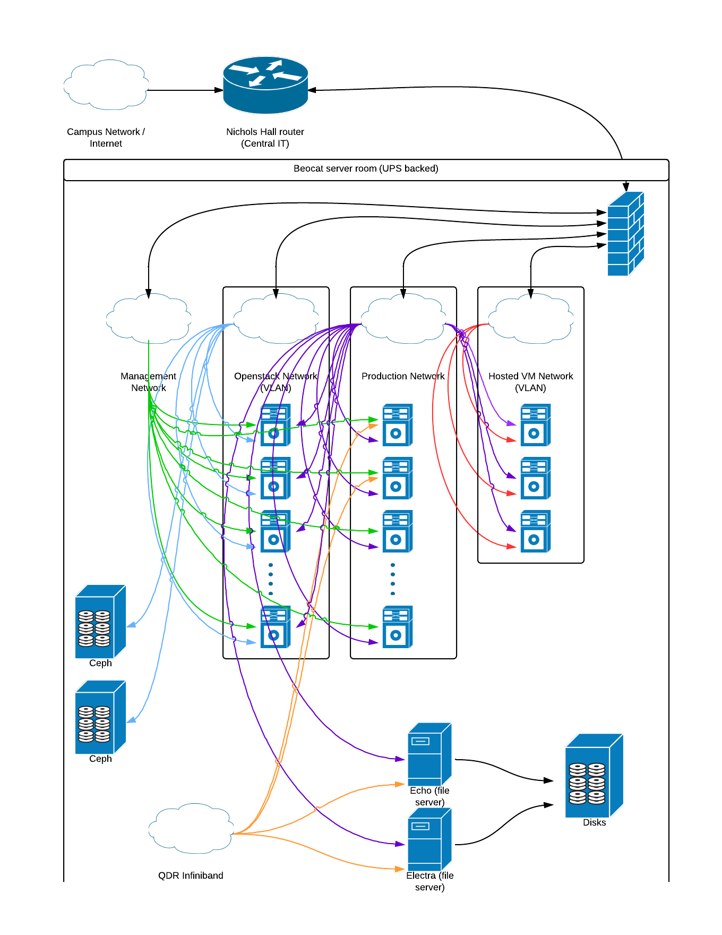
Beocat Schematic

Slide 28
Beocat users history

Slide 29
Beocat cores history

Slide 30
Beocat compute nodes
Scouts (76)
Oldest in production
2x 4-core Opteron 2376 (2.3 GHz)
8 GB RAM

Slide 31
Beocat compute nodes
Paladins (16)
2x 6-core Intel Xeon X5670 (2.93 GHz)
24 GB RAM
CPUmark 8571
1x nVidia Tesla m2050 GPU
Infiniband

Slide 32
Beocat compute nodes
Mages (6)
8x 10-core Intel Xeon E7-8870 (2.4 GHz)
1024 GB RAM
Infiniband

Slide 33
Beocat compute nodes
Elves (38) – with more coming soon.
2x 8-core Intel Xeon E5-2690 (2.9 GHz) – fastest readily-available CPU line from Intel
64 GB RAM
Infiniband

Slide 34
Introducing Beocat
How to get an account
Logging in
Creating programs
Running your own toolkits
Running jobs on the head nodes
Limit 1 hr CPU time
Limit 1 GB RAM
(Mostly) used for testing

Slide 35
Beocat Tour

Slide 36
Submitting Jobs
What happens when you submit a job?
qsub command
http://support.cis.ksu.edu/BeocatDocs/SunGridEngine
Multi-core environments
Time requirements
RAM requirements (PER CORE!)
Note the defaults
~kylehutson/beocatintro/sample.qsub

Slide 37
Monitoring jobs
‘status’
‘qsched’ (written by Adam Tygart)
‘qstat’

Slide 38
Manipulating jobs
‘qalter’ – change parameters before it starts running
‘qdel’ – delete a job from the queue

Slide 39
For more info
Beocat support pages: http://www.beocat.cis.ksu.edu/
Email the sysadmins: beocat@cis.ksu.edu

Slide 40
Array jobs
When is this useful?
~kylehutson/submit-array.qsub

Slide 41
Variable number of cores
qsub … -pe single 2|3|5-8|10|16 …
Environment variable ‘nslots’ is given to the running program
Can be very useful with OpenMP
Why is this useful?

Slide 42
CUDA
http://support.cis.ksu.edu/BeocatDocs/Cuda
When is CUDA a good/bad fit?
Compile with ‘nvcc’ command
qsub … -l cuda …

Slide 43
Hadoop
A MapReduce Framework

Slide 44
Hadoop Overview
Hadoop is a framework that implements the MapReduce programming paradigm.
You write jobs that split or sort the imported data into queues to be processed
The queues are processed and then consolidated into a summary

Slide 45
Hadoop Jobs
MapReduce framework written in Java
Each “job” is a jar file
The jar file will have at least 3 classes
Job Class
Defines the job to be run, including configuration and resources
Mapper Class
Sorts the input data to be processed by a “reducer”
Reducer Class
Reduces (summarizes) the data into useful information

Slide 46
Hadoop Filesystem
Hadoop has its own Filesystem (HDFS). This filesystem is replicated and the data nodes are typically the same nodes the hadoop jobs run on
On Beocat, this filesystem is 10TB total, but all files are stored 3 times, reducing our capacity to ~3TB. This is not meant for long-term storage.
You would put your data into this filesystem like the following:
hadoop fs -put <file in your homedir> <file in hdfs>
You can get your hadoop data out with:
hadoop fs -get <file in hdfs> <file in your homedir>
Please clean up your folder in hadoop when you are done!

Slide 47
Hadoop Example
We will now run a hadoop example job
hadoop fs -mkdir data.in
hadoop fs -put ~mozes/dna-med data.in/dna-med
hadoop jar /usr/lib/hadoop-0.20-mapreduce/hadoop-examples.jar data.in data.out
hadoop fs -get data.out dna-med.out
hadoop fs -rm -r -f data.in data.out

Slide 48
Questions?

